Slide 1
Elements of literature
CONFLICTS

Slide 2
The basic conflicts in literature
The main character always determines the problem and how it will be solved. These problems are classified as conflicts. These conflicts are…
MAN VS MAN
MAN VS SOCIETY
MAN VS HIMSELF
MAN VS NATURE
MAN VS SUPERNATURAL
MAN VS THE UNIVERSE
MAN VS THE MACHINE

Slide 3
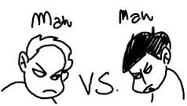
MAN VS MAN – (another character) The leading character struggles with his physical strength against other men
The main character is called the protagonist.
The person in conflict with the protagonist is called the antagonist.
When the antagonist is another person, then the conflict is called Man (even if it is a female) versus Man (even if it is a female.
Remember that “man” is a generic term meaning it could be a either a male and female.
Click on the title above and see an example.
1.What is Man vs. Man Conflict?
Very simply stated Man vs. Man conflict is where two people fight each other. Two really good examples in Literature of this kind of conflict are:
Sarah Connors vs. the Terminator in The Terminator series.
Special Agent Starling vs. Doctor Hannibal (the cannibal) Lextor in The Silence of the Lamb.

Slide 4
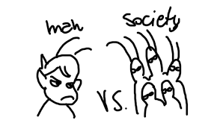
Man versus society
The protagonist can have many conflicts with society. He could
1. be an outsider, not accepted by society
2. be a stranger
3. be a person who breaks the law, be it a just and unjust law
4. be a victim or example of a type of person about which society discriminates
5. be a victim of crime
6. be a crusader

Slide 5
What are a good examples of a Man vs. Society conflict?
Rosa Parks / bus, and later water fountain - the Nine who had to be escorted to go to school for desegregation - Oklahoma bombing - Wako cult - Charles Manson / any other cult - FLS leader Warren Jeffries -Tom Cruise, Michael Jackson, Jerry Springer lol any number of "celebrities" in their own world -Moses vs. Pharaoh/Egypt -Gandhi/Indians vs. British rule so many to choose from! choose whether you want a positive or negative role model/result.

Slide 6
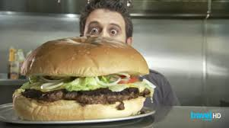
Man versus self
3. Man vs. Himself
Man vs. Himself/Herself (psychological) - The leading character struggles with himself/herself; with his/her own soul, ideas of right or wrong, physical limitations, choices, etc. Internal - A struggle within one's self; a person must make some decision, overcome pain, quiet their temper, resist an urge, etc.

Slide 7
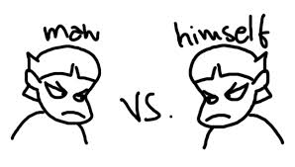
Man vs. Himself
Man vs. Himself/Herself (psychological) - The leading character struggles with himself/herself; with his/her own soul, ideas of right or wrong, physical limitations, choices, etc. Internal - A struggle within one's self; a person must make some decision,
overcome pain, quiet their temper, resist an urge, etc.
Man vs. himself
Perhaps the most profound conflict a character can face is when he is at odds with himself. Conflicts in which the protagonist faces off against other individuals or society often result in characters that represent ideals and concepts. But the character that first must deal with his own foibles in order to overcome a villain or oppressive values has learned something. He has grown as a character and become a better human being. Ideally, your readers will grow with this character, making his triumph over others more lasting in the readers’ minds.
An example of man vs. himself conflict is Anakin Skywalker’s internal struggle in “Star Wars III: Revenge of the Sith” in which the young jedi must decide if he will serve the powers of good or turn to the Dark Side. In this case, Skywalker makes the wrong choices and becomes the villain Darth Vader.
If handled correctly, a man vs. himself conflict can raise a story to high art. The “Star Trek: The Original Series” episode “The City on the Edge of Forever” in which Captain Kirk must decide between his love for a woman and his responsibility to the future of humanity is modern tragedy. In Stanslaw Lem’s “Solaris”, a psychologist is reunited with what appears to be his wife but in reality is an amalgam of his memories of her. The result is an intense psychological struggle worthy of the best contemporary literature. Arguably, your story gains sophistication when your main character must do overcome a challenge other than defeating the forces of nature or a straight villain. To survive being marooned on a desert world or succeed in taking down an alien menace, your main character ought to first have to overcome some internal conflict that in turn allows him to be victorious over nature or invader. For example, in Anne McCaffrey’s short story “The Smallest Dragonboy,” the main character Keevan must learn self-discipline and gain self-confidence to achieve his goal of becoming a dragonrider. In doing so, he overcomes the story’s wider challenge of being ridiculed by the other older and stronger boys.
Your story almost always is better when a man vs. himself conflict rests at its core.

Slide 8
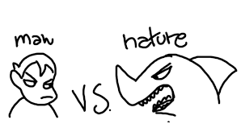
Man versus nature: (tornado, hurricane, flood, avalanche, etc...)
Man versus Nature in American literature: Picture this: the protagonist is in a boat at sea and a storm comes up. In order to survive, he must figure out how to steer the boat, how to avoid drowning; how to avoid being eating by sharks; how to get enough good water so he doesn’t die of dehydration; how not to die from exposure.
These are all examples of Man vs Nature.
Battling an animal, the weather, events in
nature and disease are all examples of Man vs Nature.

Slide 9
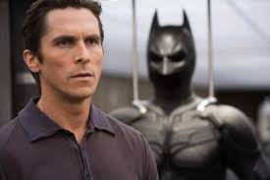
Man versus the supernatural
Man can be in conflict with any number of non-human beings. Examples are
God
The devil
Aliens from outer space
Ghosts
The undead
Vampires
You get the idea

Slide 10
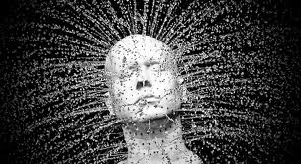
Man versus the universe
Think of this: the planets revolve around the sun. Each rotates at a specific speed and takes a certain amount of time to revolve around the sun. This is the order of things. Likewise, the body of a person functions in a certain order. The heart beats at a particular rhythm, the lungs take in air at a certain rate and people eat ad digest their food on a regular basis. This is the order of things.
No think of this: chaos. Chaos is when things are not orderly. If society is function properly, there must be a certain order maintained and values associated with that order. When the values are disrupted then society is in chaos.
When a character in a story becomes involved in a chaotic situation, this this a situation of man versus the universe as the protagonist endeavors to restore order.

Slide 11
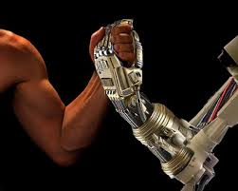
Man versus the machine
In modern society, the concept of androids and other computerized mechanisms evolves into another struggle mankind meets: mam vs the machine. This is especially true when the protagonist is not controlling the machine.
Some people might view this as a conflict with society or the mechanization of society, but it can also be viewed simple as man in conflict with a machine.

Slide 12
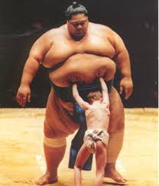
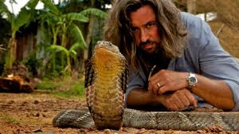
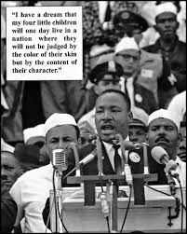
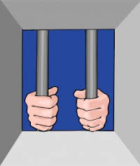
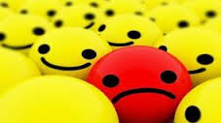
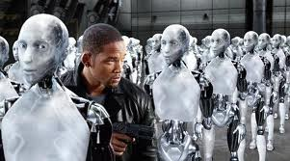
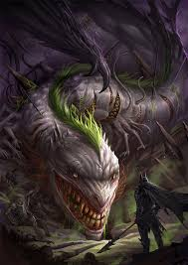
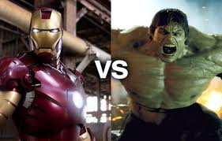
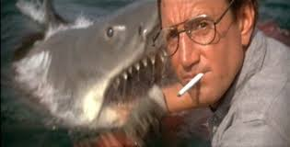

Slide 13
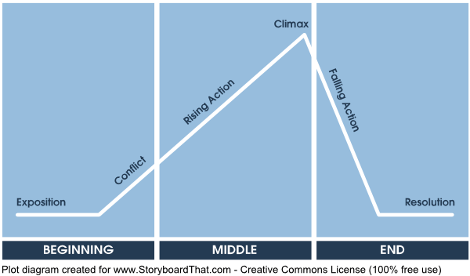
Dramatic structure
Exposition - we learn background about the story, like the setting and characters. Then there is an inciting incident, that brings the main characters out of balance.
Here I am in school, everything is totally normal! Hey, where's my dad?
Conflict: something gets in the way of the protagonist.
All I want is my daughter back but will the court let me have it?
Rising Action / Complications: We learn more details about the story, including obstacles for the protagonist.
I'm being framed for a crime I didn't commit! I have to prove my innocence to get back to my daughter.
Climax: This is the high point of the action, or the crisis point.
The evidence I needed is buried in a chest at this beach - I've found it!
Falling Action: Now the climax has finished, the story line wraps up.
Now, I can present this find to the court and I'll get to see my daughter again!
Resolution or Revelation: The story comes to an end and the plotlines are completed.
DADDY!
Beginning [Exposition, Conflict]
Middle [Rising Action, Climax]
End [Falling Action, Resolution]
Plot Diagram

Slide 14
Plot Diagram Example The Cask of Amontillado:
ExpositionDuring carnival in Italy, Montresor runs into Fortunato and offers to share a very nice bottle of Amontillado (wine) with him. However, this bottle is in his catacombs and it is late at night and Fortunato seems ill.
ConflictThe narrator, Montresor, claims that Fortunato has made a grave insult against him and so he is plotting to get his revenge.
Rising ActionMontresor lures Fortunato down into the dark and eerie wine vault. As suspense builds, Montresor keeps asking if Fortunato would like to turn back because he seems ill. However, Fortunato continues to drink wine as his cough medicine.
ClimaxWhen they reach their destination there is no Amontillado, but there is a hole in the wall. Montresor shackles Fortunato inside and begins to seal up the wall with bricks.
Falling ActionAs the last few bricks are laid, Fortunato screams for Montresor to stop, but it is too late. Montresor has enacted his revenge.
ResolutionIn the end, the narrator walks away with only the sound of Fortunato’s jingling jester bells echoing in the tomb. He replaces the bones of the crypt and exclaims that no one has disturbed them for 50 years. “In pace requiescat”.

